Slide 1
L.O. – to have an understanding or ratios, rates, unit rates and how to calculate a best buy.
Success, use ratios to split amounts and use unit rates to calculate best buys.

Slide 2
You and a friend have started a landscaping company. You invested $500 and your friend has invested $300 in tools and equipment.
The company has just made $4000 profit in the first month. How should the money be shared?

Slide 3
Topic : Ratios, rates and best buys
24
7
30
Date
EQ : How do I find the best buy
ratio – a comparison of two numbers of the same type. eg length : length volume : volume
rate – a ratio that compares different kinds of units eg km per hour $ per litre

Slide 4
There are two different types of ratios
.Part-to-Part Ratios
Example: Tamara’s dogs to cats is 2 to 8 or 1 to 4
.Part –to-Whole Ratios
Example: Tamara’s dogs to total pets is 2 to 10 or 1 to 5

Slide 5
Let’s try
The class has 30 students. Fourteen are girls.
Write the ratio for……
Girls to boys 14:16 = 7 to 8 or 7/8
Boys to girls 16:14 = 8 to 7 or 8/7
Girls to all students 14:30 = 7 to 15 or 7/15
Boys to all students 16:30 = 8 to 15 or 8/15

Slide 6
To divide by a ratio.
1. Add the different parts of the ratio together.
Eg 1:4 1+4= 5 1:3:5 1+3+5 = 9
2. Divide the amount by the total number of parts in each ratio.
Eg divide $450 by the above ratios.
Eg 1:4 1+4= 5 1:3:5 1+3+5 = 9
450 ÷ 5 = $90 per share $450 ÷ 9 = $50 per share
3. Multiply each section of the ratio by the amount per share
1 x 90 : 4 x 90 1x50 :3x50 :5x50
90 : 360 50:150:250

Slide 7
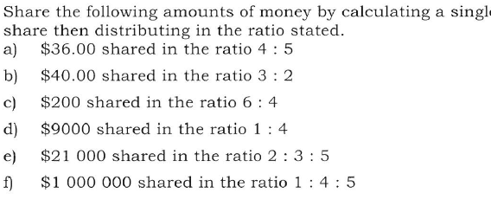

Slide 8
Rates
A rate is a ratio that compares two different quantities or measurements.
Rates can be simplified
Rates us the words per and for
Example: Driving 55 miles per hour
Example: 3 tickets for $1

Slide 9

Unit Rates
A unit rate is a rate per one unit. In unit rate the denominator is always one.
Example: Miguel types 180 words in 4 min. How many words can he type per minute?
45 . 1
45
=
or words per minute
rate unit rate word form

Slide 10
Unit rates make it easier to make comparisons such as which is the better buy.
Example; Steve buys 2 kg of flour for $6 while Ron buys 1.5kg for $4. Which is the better value?
$ per kg requires $ ÷ kg so
6 ÷ 2 = $3 per kg vs 4 ÷ 1.5 = $2.7 per kg
Therefor Ron has the best buy since he pays less per kg.

Slide 11
Topic : Ratios, rates and best buys
24
7
30
Date
EQ : How do I find the best buy
Unit rate – when we find the rate for a single unit. so 360 km for 6 hours is a rate 360 ÷ 60 = 60 therefore 60 km for 1 hour is the unit rate To find the best buy, find the unit rate and identify which is the cheapest. Eg 10 cans of coke costs $9.20 13.20 ÷ 10 = $0.92 per 1 can 24 cans of coke costs $18.60 18.6 ÷ 24 = $0.775 so the 24 can pack costs less per can so it is the best buy.

Slide 12
